Slide 1
2018 UNDP Human Development Report:
Human Development Index (HDI)

Slide 2
Table Of Contents
Executive Summary……..………………………………………………………………………………………….….2
Human Development Index (HDI)……………………………………………………………………………………3
The Human Development Index (HDI) Trend Analysis…………………………………………………………..4
Human Development Index (HDI) calculation dependencies ……….………………………………………….7
Gross National Income (GNI) Per Capita.................................………………………………………………….8
Mean Years of Schooling……………………………………………………………………………………………..10
Education Index…………………………………………………………………………………………………………11
Life Expectancy at Birth……………………………………………………………………………………………….12
Appendix – Pandas Work…....……………………………………………………………………………………….13

Slide 3
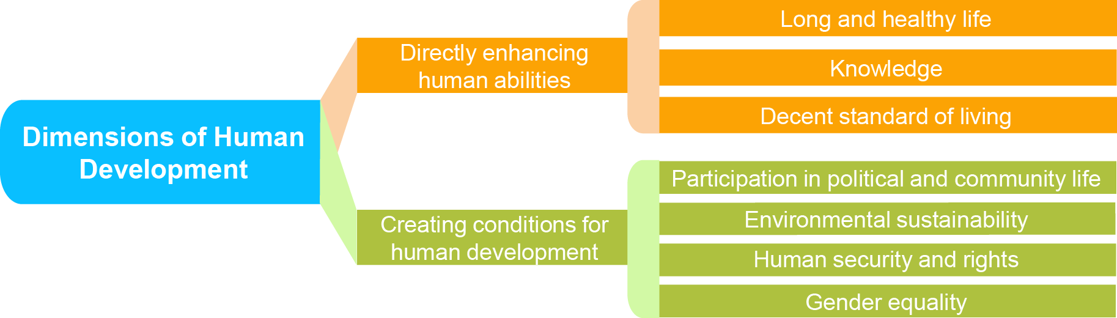
Executive Summary
The United Nations Development Program (UNDP) is the United Nations' global development network. which works in 170 countries advocating for change and connects countries to knowledge, experience and resources to help people build a better life for themselves.
UNDP’s goal is to achieve the eradication of poverty, and the reduction of inequalities and exclusion through helping countries in developing policies, leadership skills, partnering abilities, institutional capabilities and building resilience in order to sustain development results
UNDP annual Human Development report assist policy makers in improving on Health, Education, Gender Inequality,….etc

Slide 4
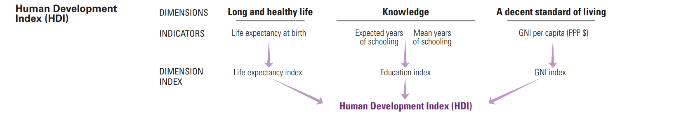
Human Development Index (HDI)
The Human Development Index (HDI) is a composite index measuring average achievement in three basic dimensions of human development which are long and healthy life, knowledge and a decent standard of living

Slide 5
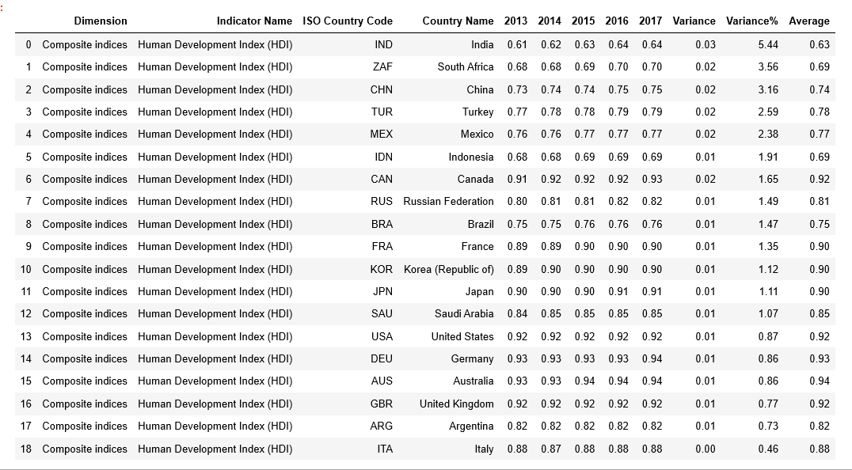
Human Development Index (HDI)
The Human Development Index (HDI) Trend Analysis
The G20 (or Group of Twenty) is an international forum for the governments and central bank governors from 19 countries and the European Union (EU). Founded in 1999 with the aim to discuss policy pertaining to the promotion of international financial stability,

Slide 6
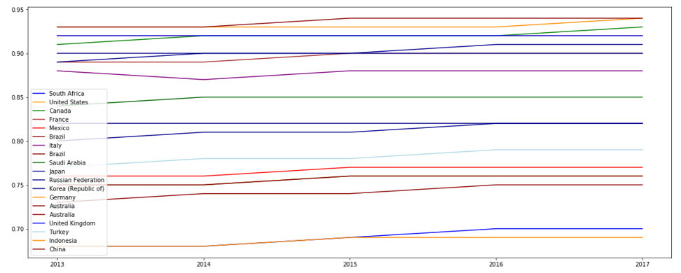
Human Development Index (HDI) G20 Countries Trend analysis

Slide 7
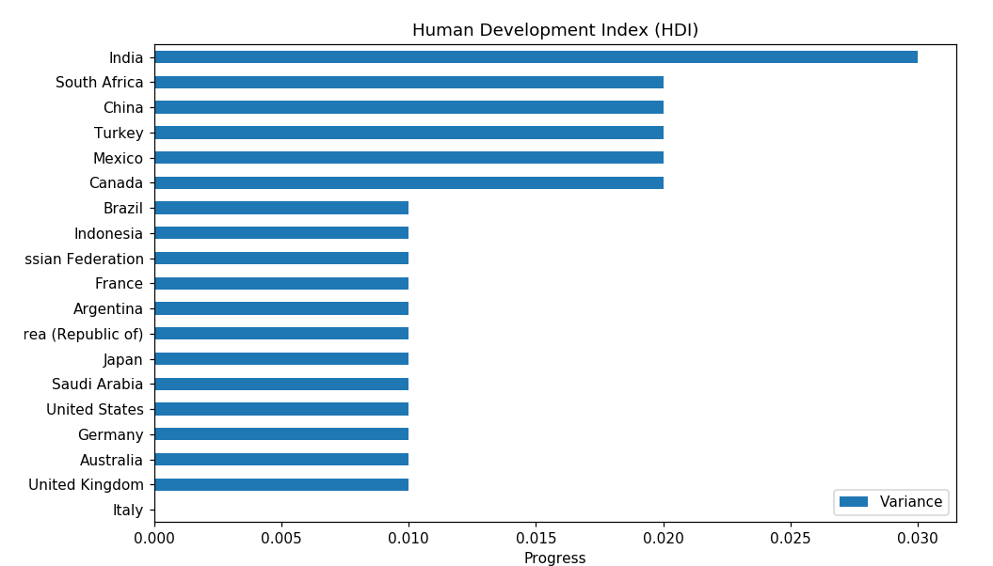
Human Development Index (HDI) G20 Countries progress analysis
** The Chart shown above is based on the numbers in the variance column on slide 3

Slide 8
Human Development Index (HDI) calculation dependencies
HDI calculation is based on the following indicators:
Mean years of schooling:
Average number of years of education received by people ages 25 and older, converted from education attainment levels using official durations of each level.
ii.Gross National Income per Capita (2011 PPP $):
Aggregate income of an economy generated by its production and its ownership of factors of production, less the incomes paid for the use of factors of production owned by the rest of the world, converted to international dollars using PPP rates
iii. Expected years of schooling:
Number of years of schooling that a child of school entrance age can expect to receive if prevailing patterns of age-specific enrolment rates persist throughout the child’s life
iv Education Index:
Number of years of schooling that a child of school entrance age can expect to receive if prevailing patterns of age-specific enrolment rates persist throughout the child’s life
v. Life Expectancy at birth:
Number of years a newborn infant could expect to live if prevailing patterns of age-specific mortality rates at the time of birth stay the same throughout the infant’s life.
vi. Life Expectancy Index
Life expectancy at birth expressed as an index using a minimum value of 20 years and a maximum value of 85 years
vi. Income Index:
GNI per capita (2011 PPP International $, using natural logarithm) expressed as an index using a minimum value of $100 and a maximum value $75,000.

Slide 9
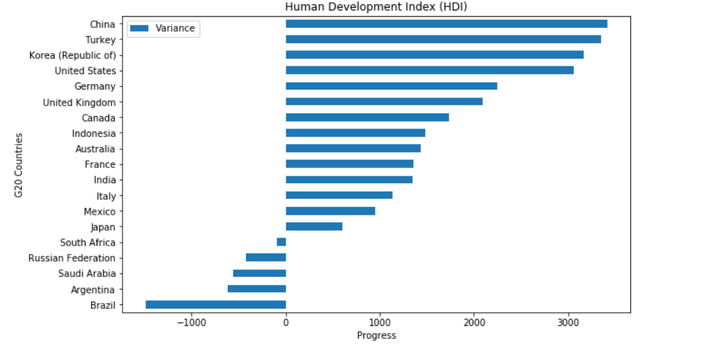
Human Development Index (HDI) calculation dependencies
Gross National Income (GNI) Per Capita
Gross National Income per Capita (2011 PPP ): Aggregate income of an economy generated by its production and its ownership of factors of production, less the incomes paid for the use of factors of production owned by the rest of the world, converted to international dollars using PPP rates

Slide 10
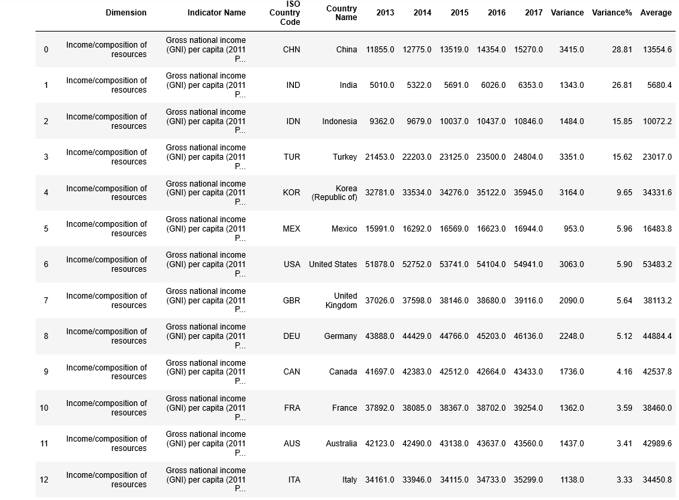
Human Development Index (HDI) calculation dependencies
Gross National Income (GNI) Per Capita
** The Chart shown above is based on the numbers in the variance column on slide 3

Slide 11
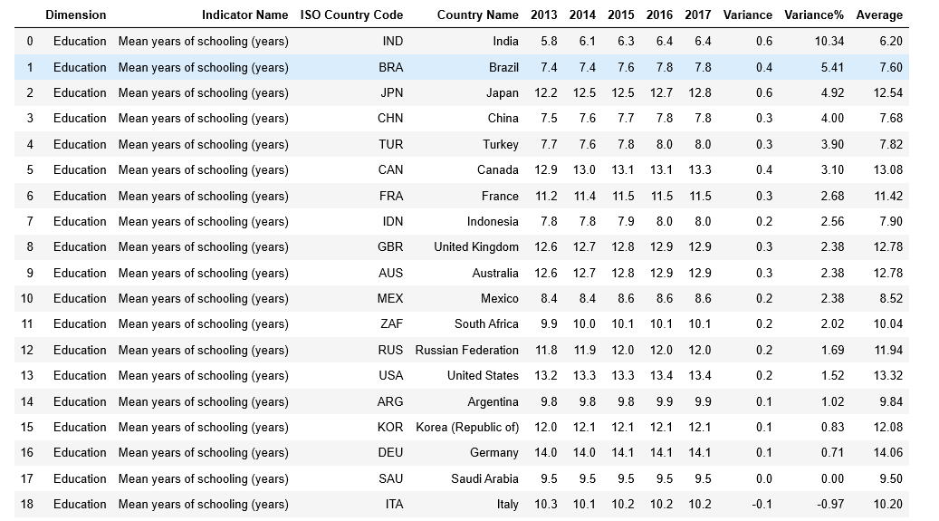
Human Development Index (HDI) calculation dependencies
Mean Years of Schooling
** The Chart shown above is based on the numbers in the variance column on slide 3

Slide 12
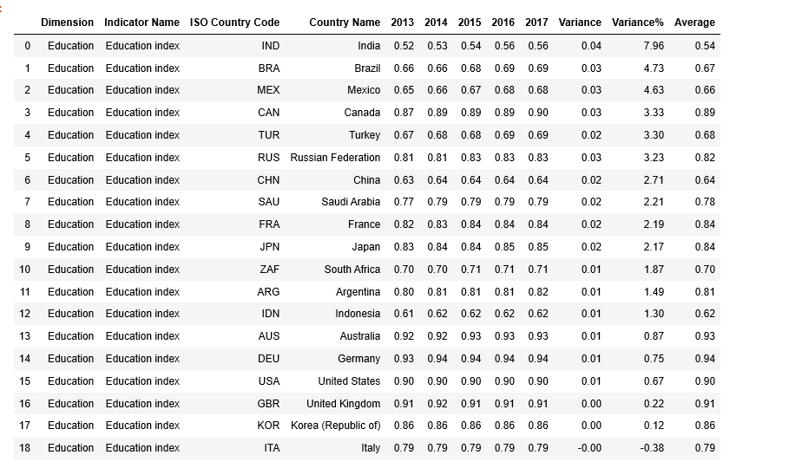
Human Development Index (HDI) calculation dependencies
Education Index
** The Chart shown above is based on the numbers in the variance column on slide 3

Slide 13
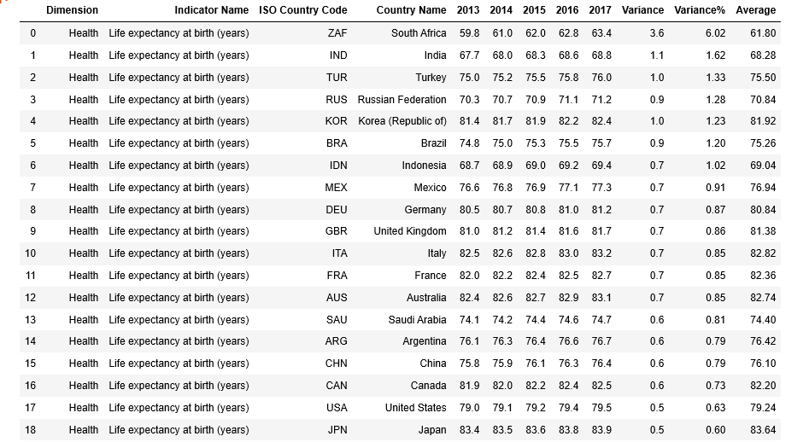
Human Development Index (HDI) calculation dependencies
Life Expectancy at Birth
** The Chart shown above is based on the numbers in the variance column on slide 3

Slide 14
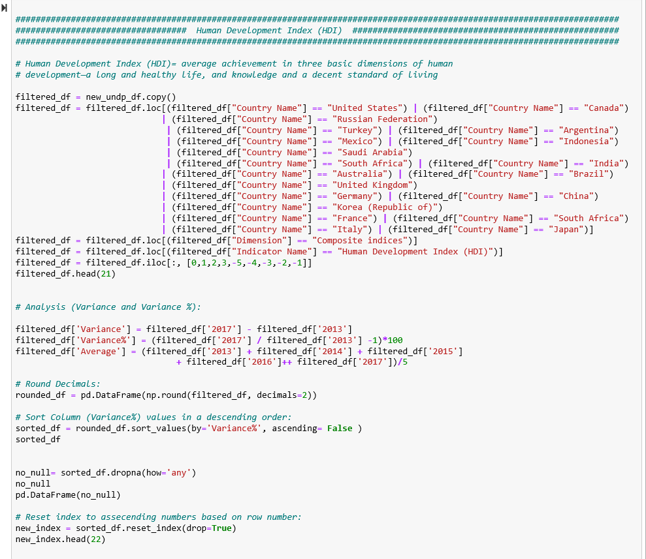
Appendix
Pandas work
** The Chart shown above is based on the numbers in the variance column on slide 3

Slide 15
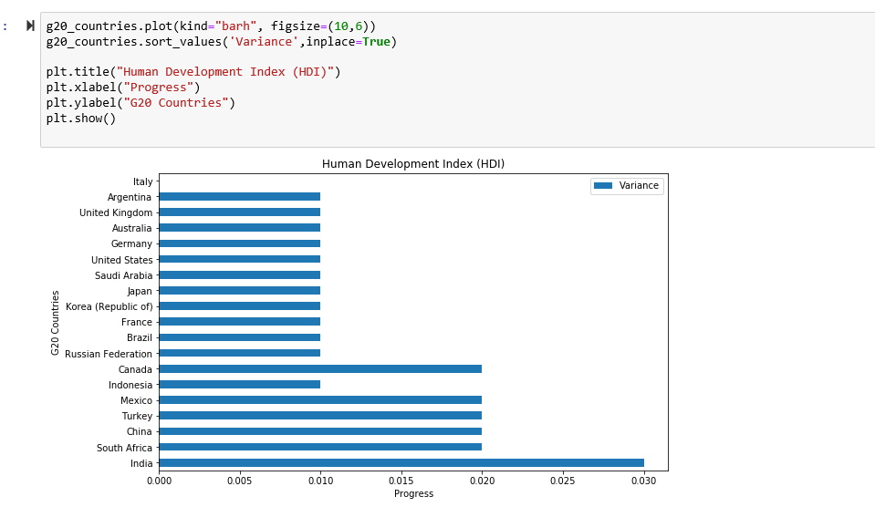
Appendix
Pandas work
** The Chart shown above is based on the numbers in the variance column on slide 3

Slide 16
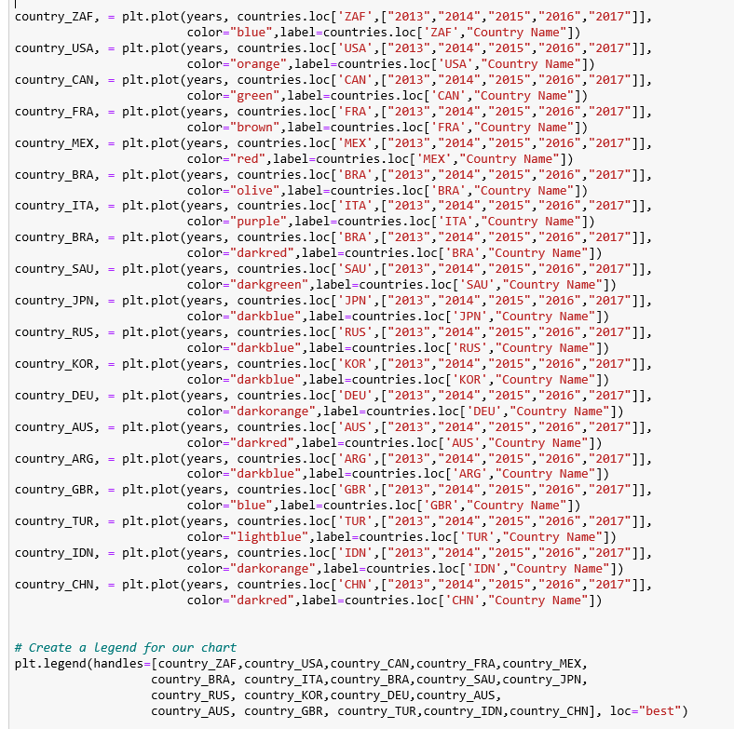
Appendix
Pandas work

Slide 17
Thank You!

